Slide 1


Ejercicio de rieso de sesgo:
Pragmatic randomized controlled trial of long-term psychoanalytic psychotherapy for treatment-resistant depression: the Tavistock Adult Depression Study (TADS)
Liceo Contextual
14/06/2025
Santiago Castiello de Obeso, D.Phil.

Slide 2
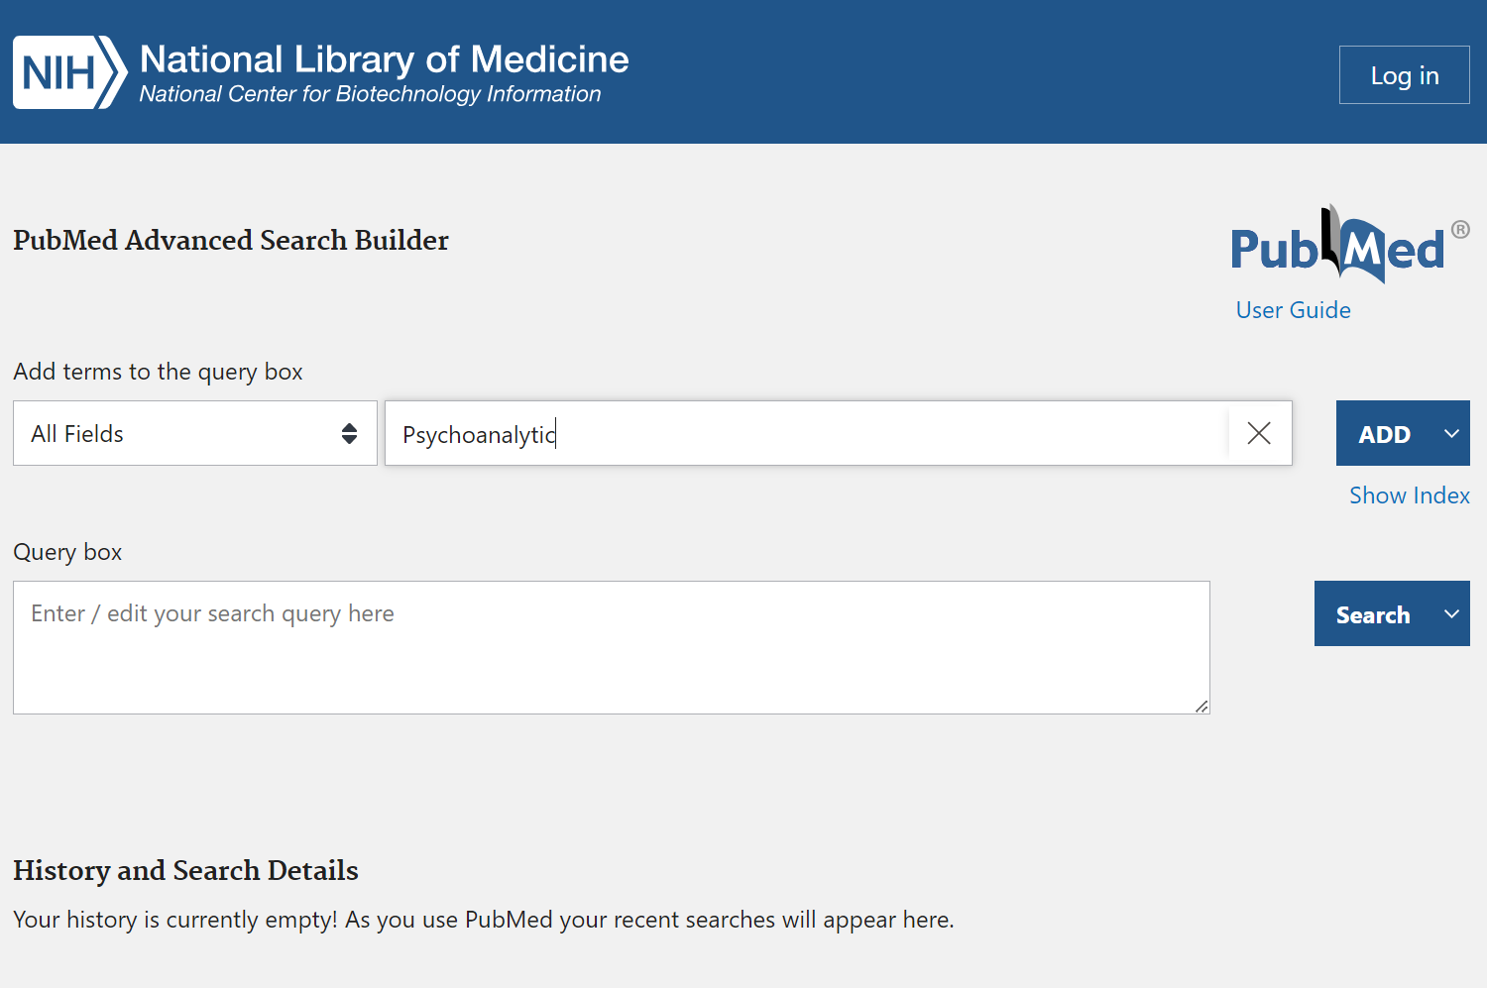

Slide 3
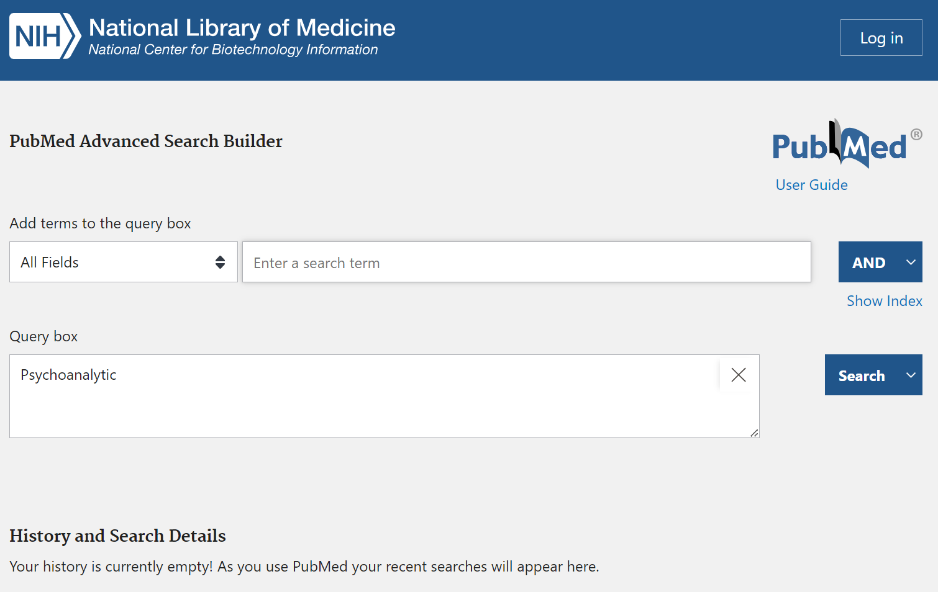

Slide 4
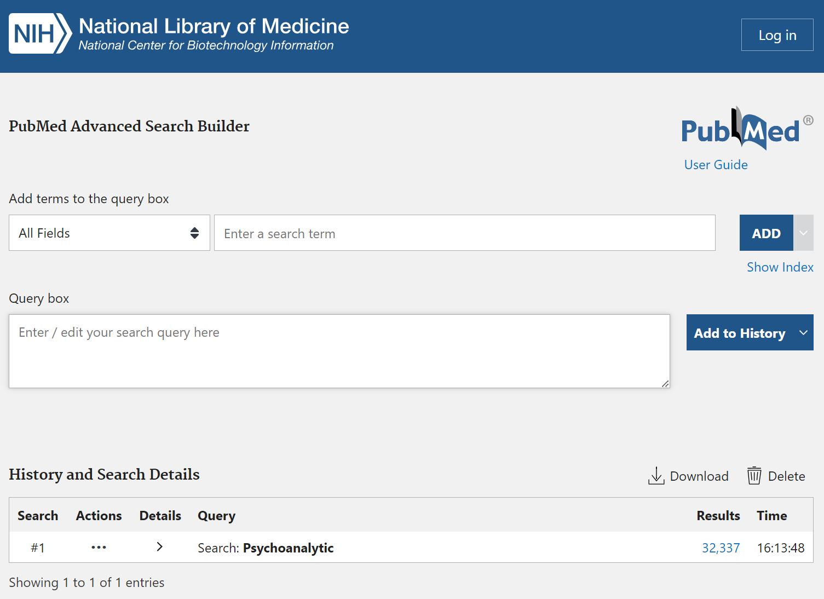

Slide 5
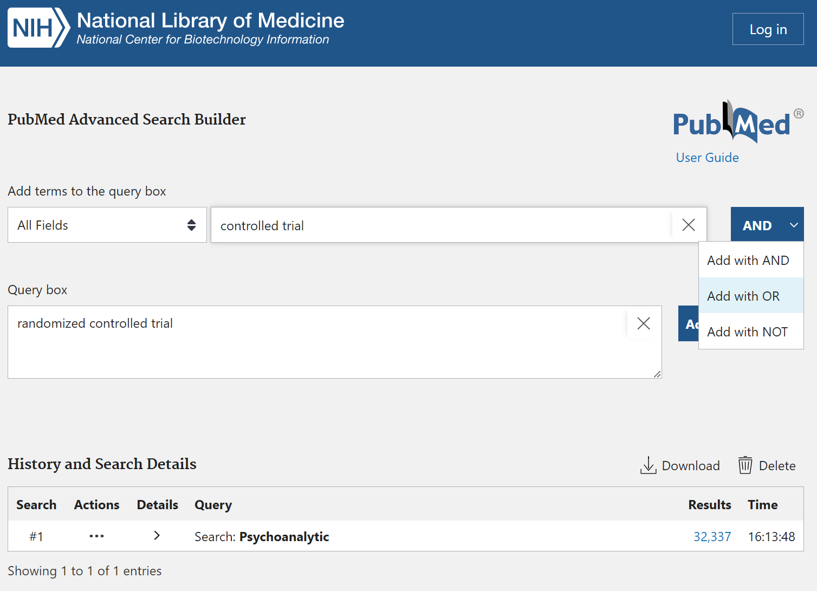

Slide 6
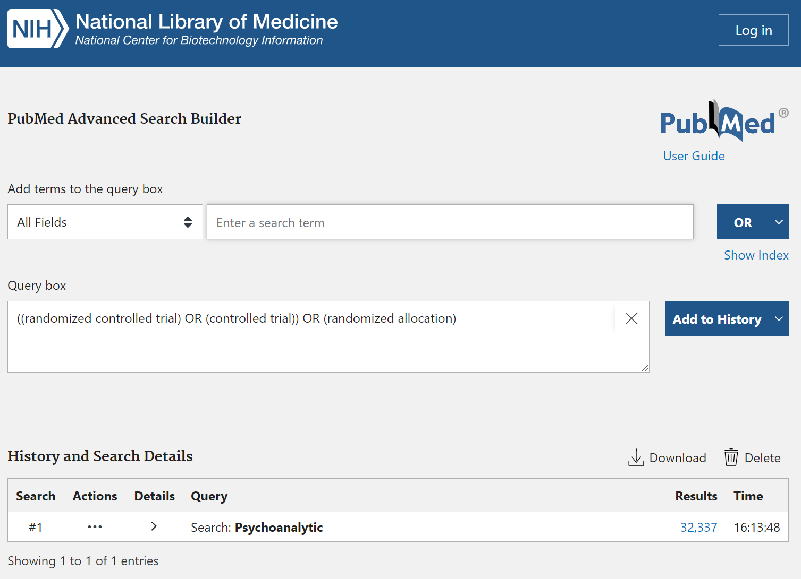

Slide 7
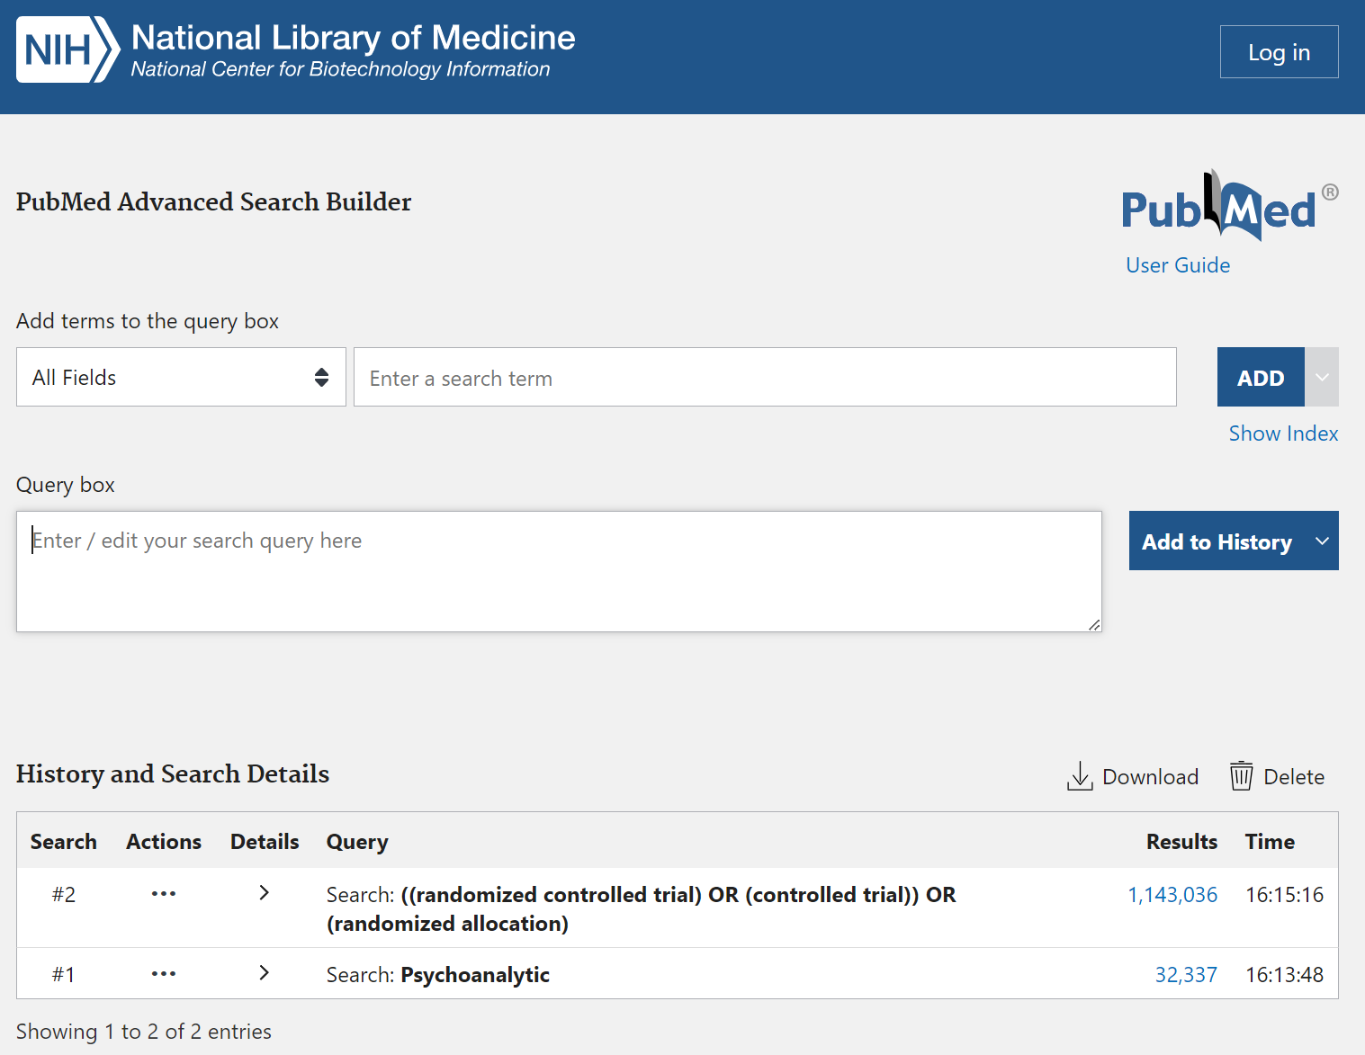

Slide 8
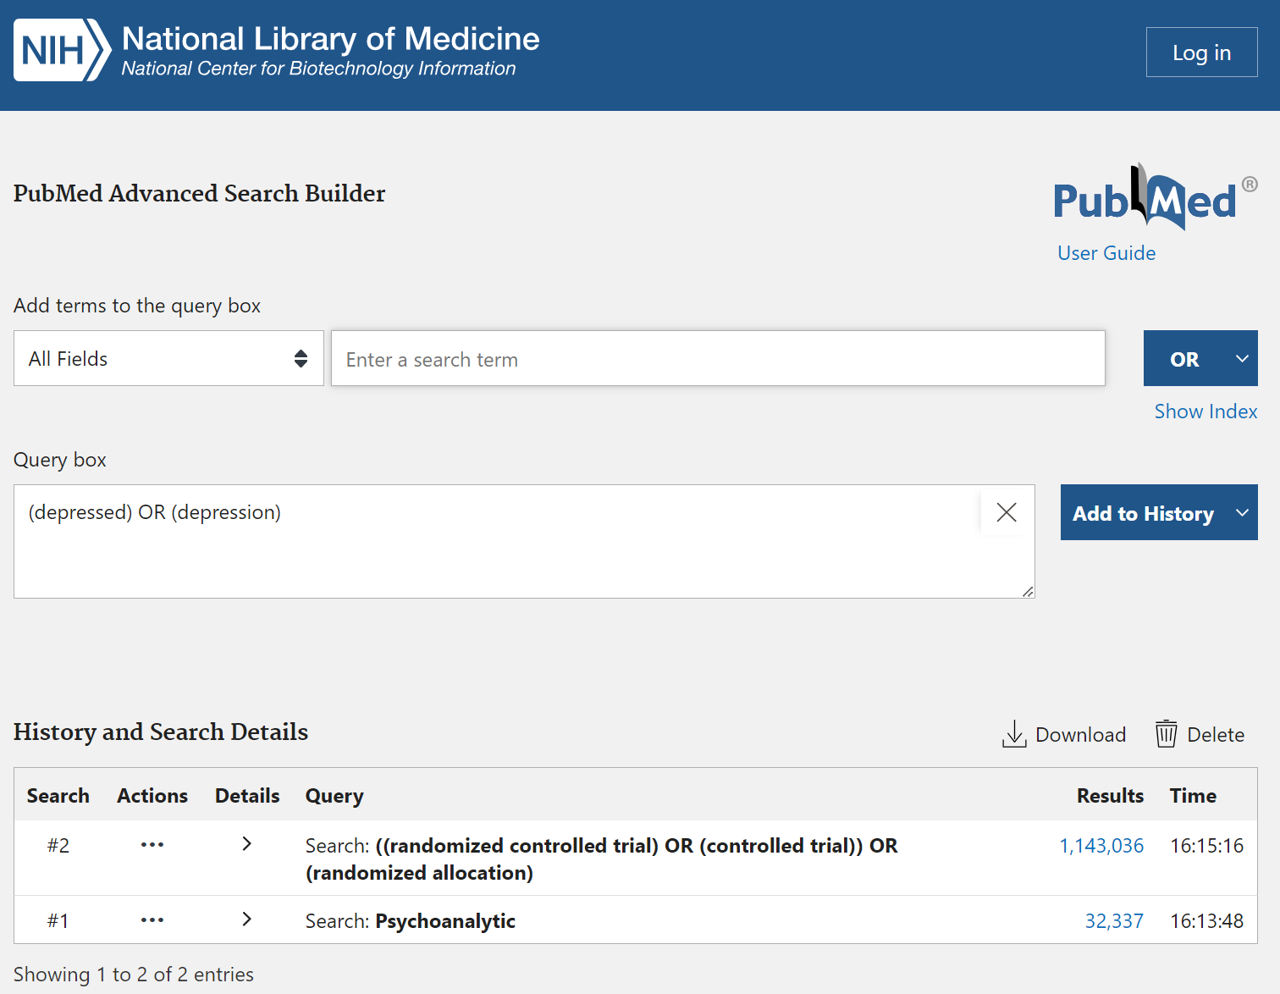

Slide 9
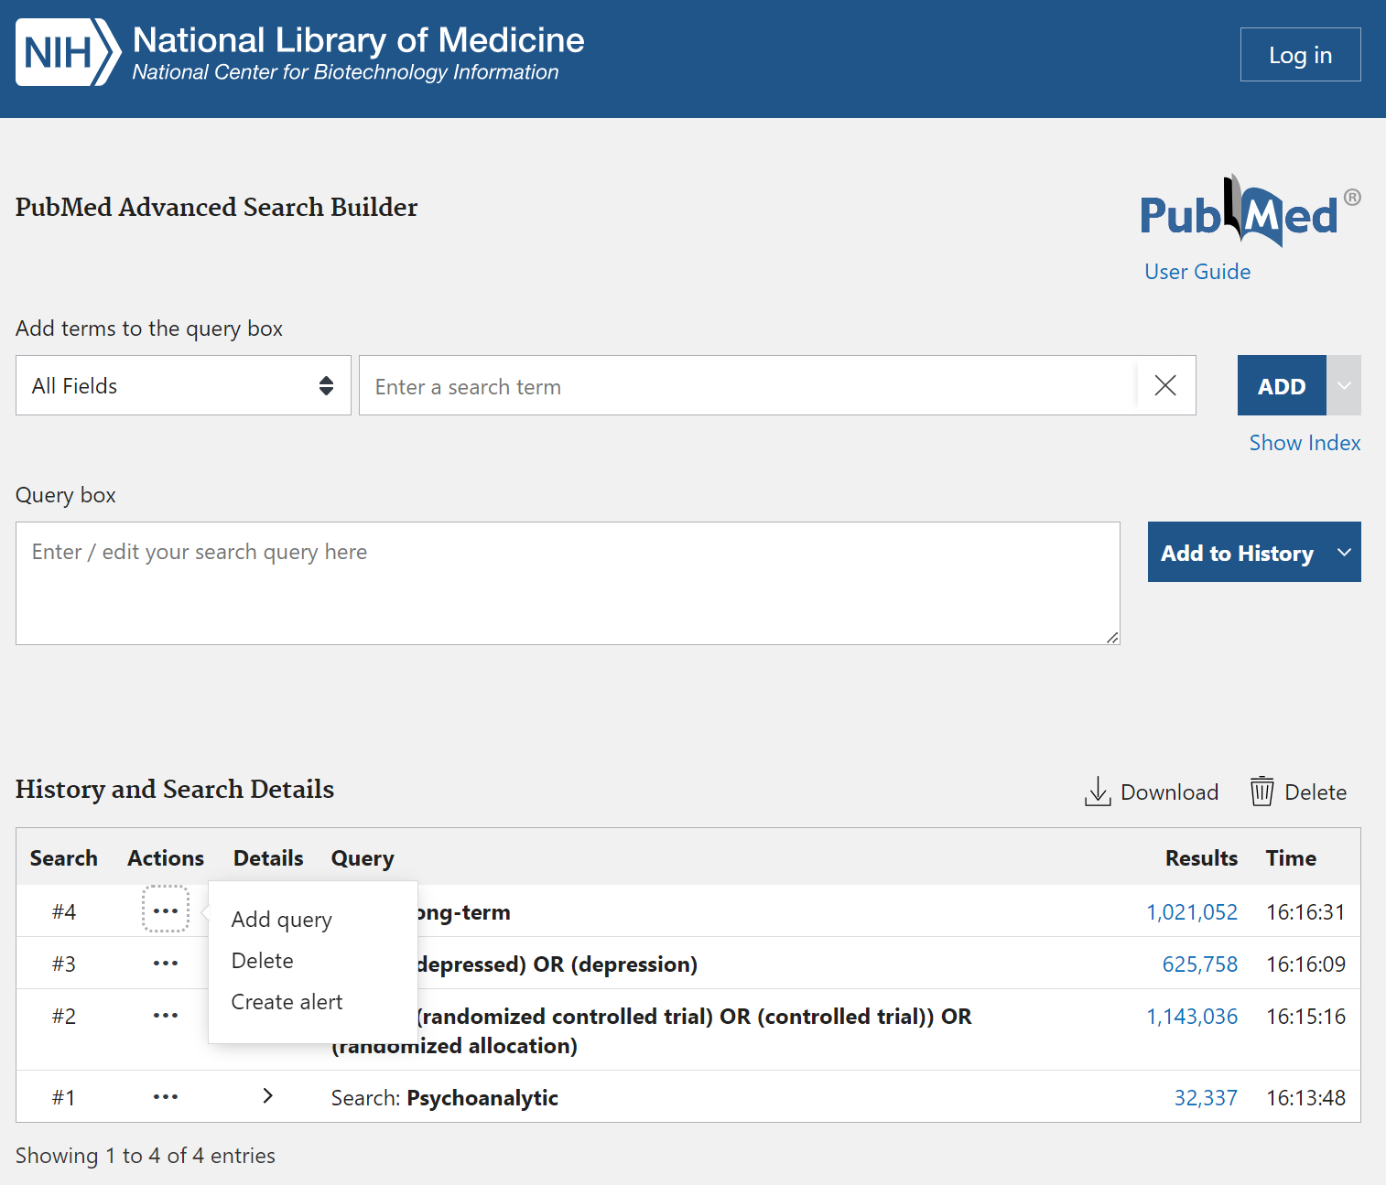

Slide 10
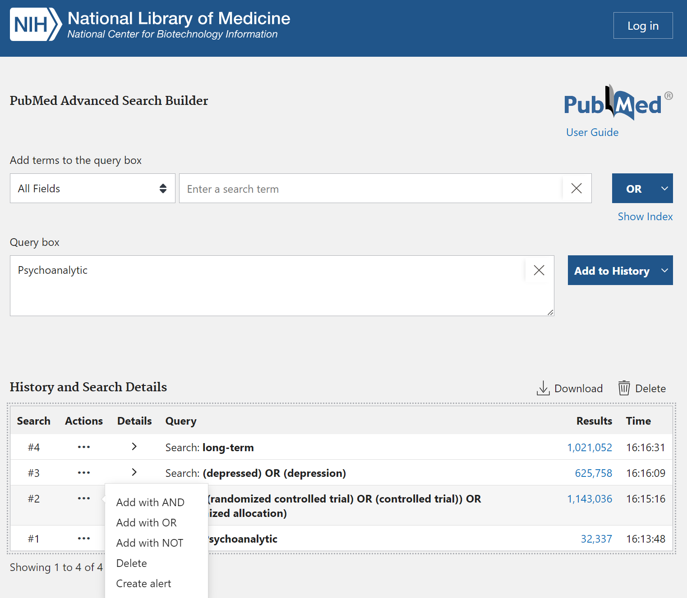

Slide 11
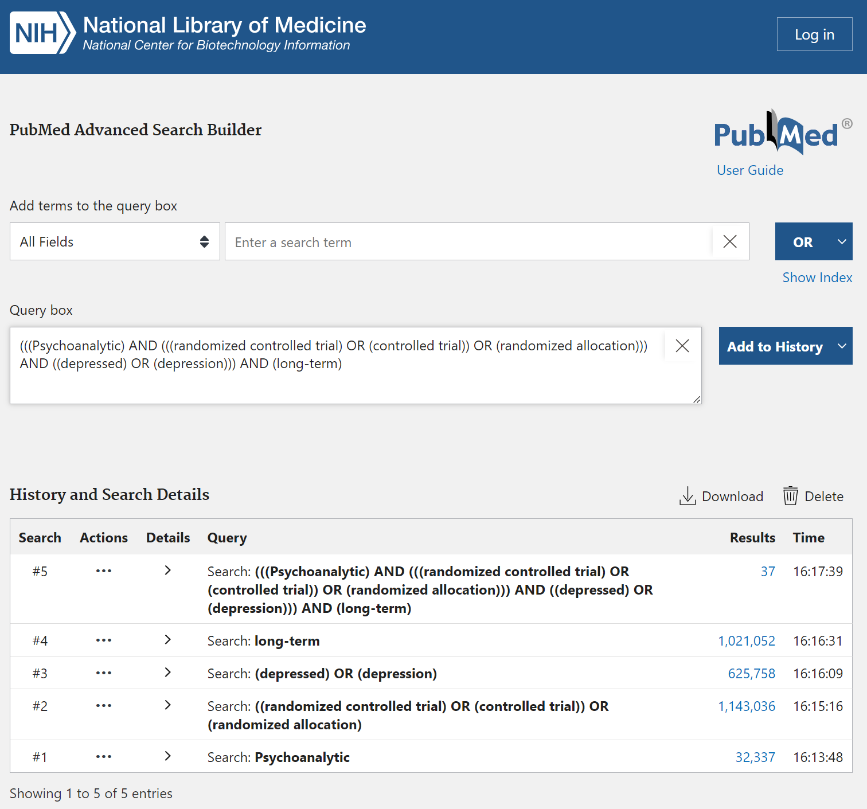

Slide 12
Ejercicio de rieso de sesgo:
Pragmatic randomized controlled trial of long-term psychoanalytic psychotherapy for treatment-resistant depression: the Tavistock Adult Depression Study (TADS)
Liceo Contextual
14/06/2025
Santiago Castiello de Obeso, D.Phil.

Slide 13
Aplicación de la herramienta de Riesgo de Sesgo

Slide 14
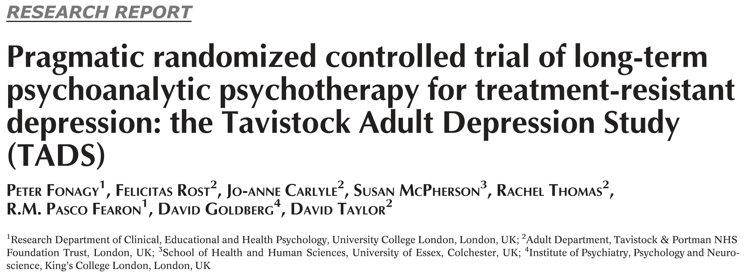
0. Introduction

Slide 15
Intervención:
50 minutos 1 vez a la semana durante 60 sesiones a lo largo de 18 meses.
17.5 años promedio de experiencia de los terapeutas
Control (TAU treatment as usual):
-dependiendo el pais es lo “usual” del tratamiento
Evaluaciones:
6, 12 y 18 meses durante el tratamineto, y a los 24, 30 y 42 meses de seguimiento

Slide 16
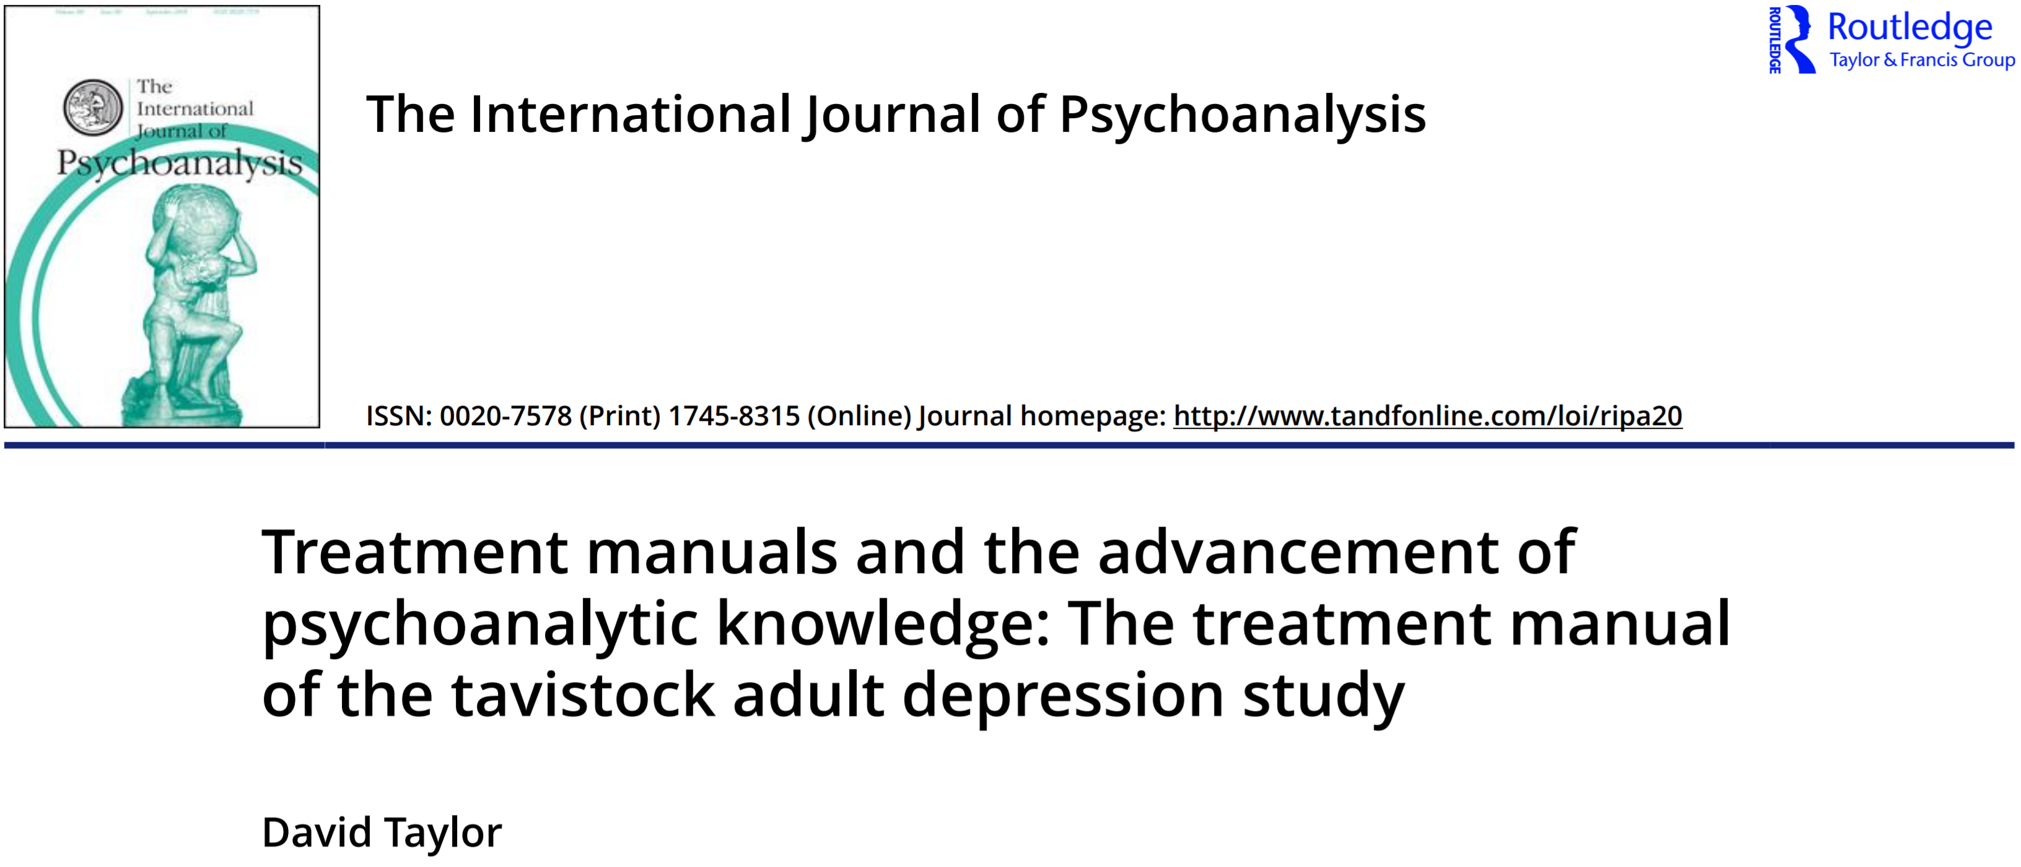
0. Introduction

Slide 17
0. Introduction
Study design:
Intention-to-treat pragmatic single-centre randomised controlled trial
PICO for clinical trials and systematic reviews
Patient | People with treatment-resistant depression
Intervention | Long Term Psychoanalytic Psychotherapy (LTPP)
Comparison | Treatment as Usual (define in NICE guidelines, i.e. GP decision-making)
Outcome | Depression symptoms, functionality, subjective wellbeing, and quality of life
1. Internal validity
2. External validity

Slide 18
1. Internal validity
Methodological bias:
“a systematic error, or deviation from the truth, in results...”
(8.2.1 'Bias' and 'risk of bias', Higgins and Green, 2011)
selection,
performance,
detection,
attrition,
reporting, and
other biases
Higgins JPT, Green S (editors). Cochrane Handbook for Systematic Reviews of Interventions Version 5.1.0 [updated March 2011]. The Cochrane Collaboration, 2011. Available from www.handbook.cochrane.org.

Slide 19
1. Internal validity
Selection bias
Random sequence generation
Allocation concealment
How does the randomization was made?
“randomization […] was carried out offsite by an independent statistician using a stochastic minimization program (MINIM) balancing for gender, depression severity (scores of 21-39 or 40+ on the Beck Depression Inventory - II, BDI-II), and medication (on/off).”
(pp. 313, Study design and participants; Fonagy, et al. 2015)
How does the researchers concealed the random sequence?
Unclear. Not stated.

Slide 20
1. Internal validity
Performance bias
Blinding of participants and personnel
Does the participants and personnel have been blinded?
No, psychological intervention is not possible.
Implication potential expectation effect or different hawthorn effect between groups.

Slide 21
1. Internal validity
Detection bias
Blinding of outcome assessment
Does the evaluator have been blinded?
“Trained interviewers blinded to treatment condition conducted the evaluations. All evaluations were recorded, and all interviews were double-rated by an independent blinded coder to establish inter-rater reliability”
(pp. 314, Assessments; Fonagy, et al. 2015)

Slide 22
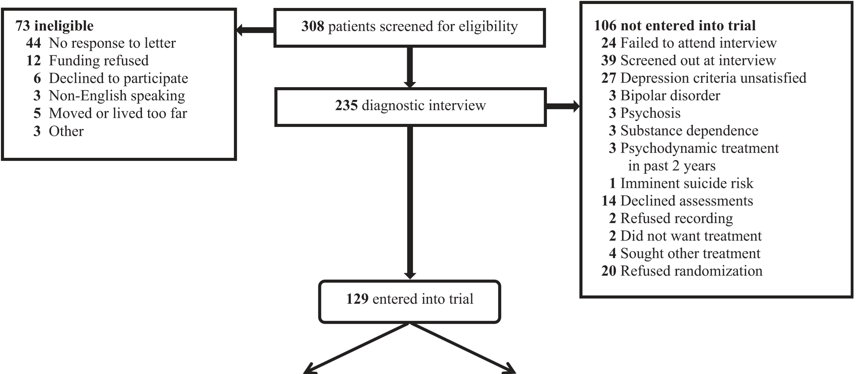
1. Internal validity
Attrition bias
Incomplete outcome data
Differential attrition between groups
Patients were then followed up for 24 to 42 months post-randomisation according to an intention-to-treat design.”
(pp. 313, Study design and participants; Fonagy, et al. 2015)
Notes:
CONSORT (Consolidated Standards Of Reporting Trials) encompasses various initiatives developed by the CONSORT Group to alleviate the problems arising from inadequate reporting of randomized controlled trials.

Slide 23
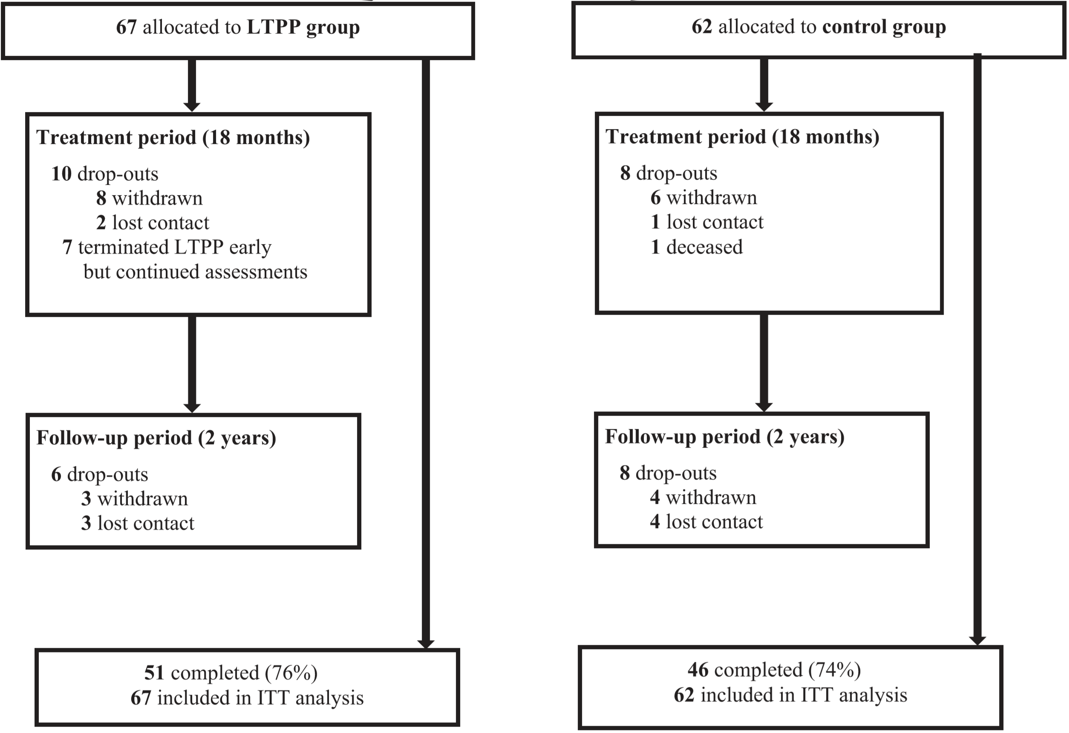
1. Internal validity
“Always randomised always analysed”
Attrition bias
Incomplete outcome data
Differential attrition between groups
Patients were then followed up for 24 to 42 months post-randomisation according to an intention-to-treat design.”
(pp. 313, Study design and participants; Fonagy, et al. 2015)

Slide 24
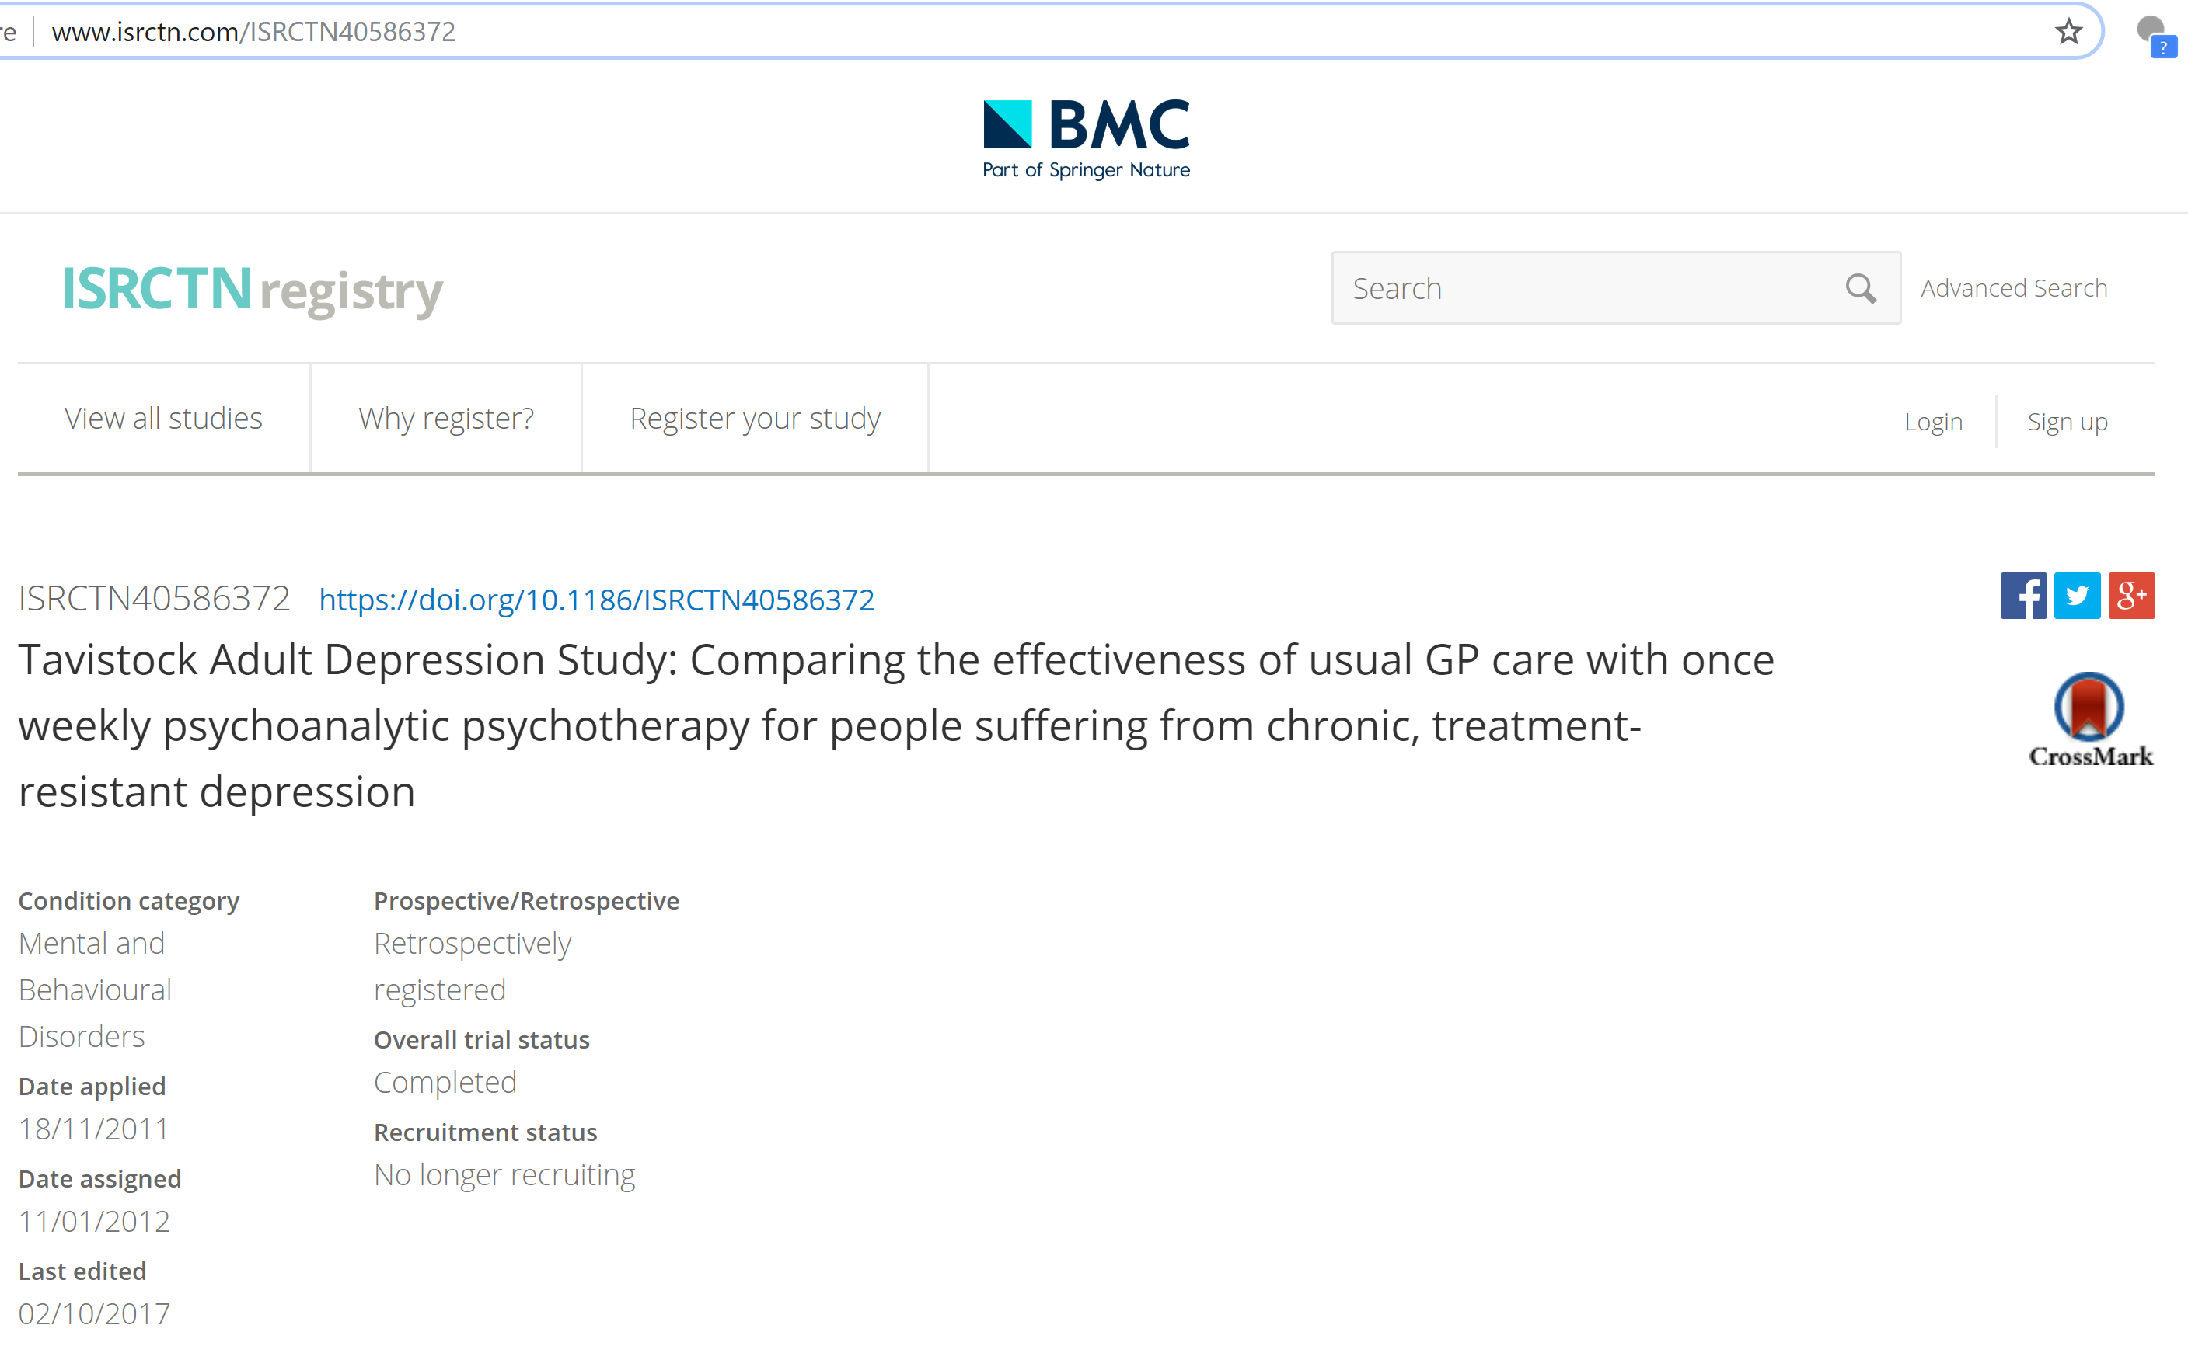
1. Internal validity
Do they have published a previous protocol?
Reporting bias
Selective reporting
“Primary outcome measure
Change in depression severity as indicated by the independent, double-rated Hamilton Rating Scale of Depression (HRSD, Hamilton, 1967) at baseline, 3 months, 6 months, 9 months, 12 months, 15 months, 18 months, 6 months follow-up, 12 months follow-up and 24 months follow-up. It is a semi-structured interview consisting of 21 depression items, which yield a range of scores from 0 - 62.” (Taylor, 2012).
Taylor, D., Carlyle, J. A., McPherson, S., Rost, F., Thomas, R., & Fonagy, P. (2012). Tavistock Adult Depression Study (TADS): a randomised controlled trial of psychoanalytic psychotherapy for treatment-resistant/treatment-refractory forms of depression. BMC psychiatry, 12(1), 60.

Slide 25
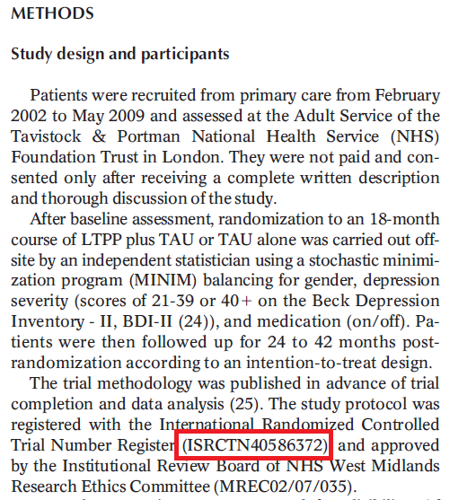

Slide 26
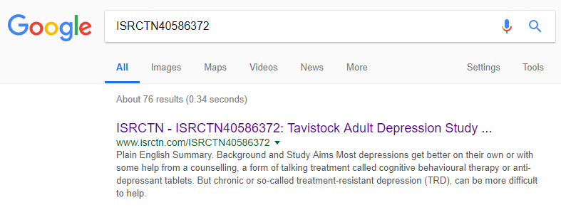

Slide 27
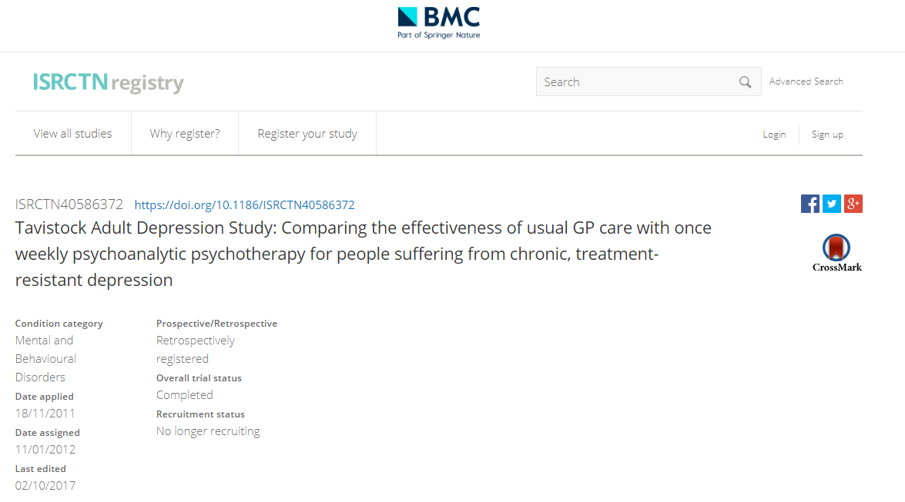

Slide 28
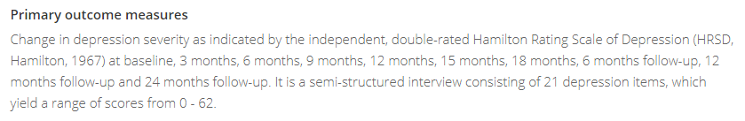

Slide 29
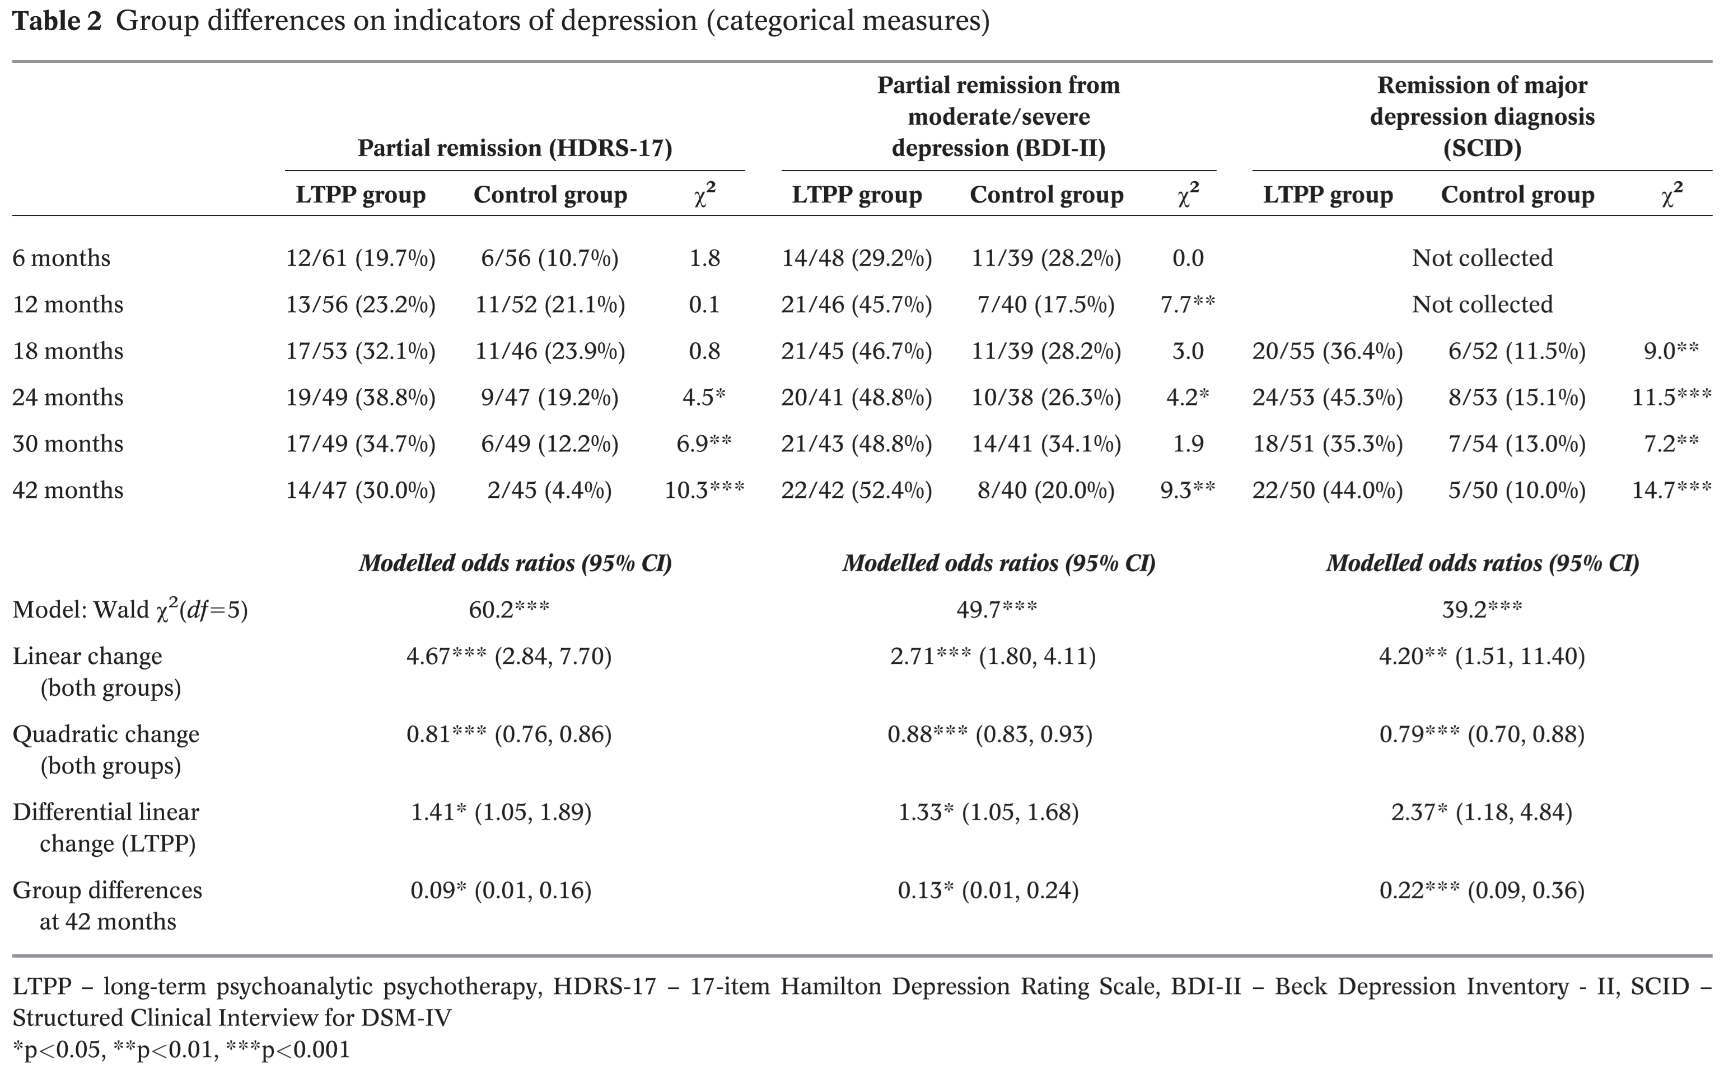
1. Internal validity
Reporting bias
Selective reporting

Slide 30
1. Internal validity
Are the therapists qualiﬁed to deliver psychological therapy?
All the therapists […] had a mental health qualiﬁcation and a training approved by the British Psychoanalytic Council
(pp. 313, Treatment; Fonagy, et al. 2015)
Other bias
Therapist qualiﬁcation/training
Treatment ﬁdelity
Researcher allegiance
Was the therapy monitored against a manual or a scale through audiotapes or videotapes?
All therapy sessions were audio-recorded. Fidelity to treatment was assessed with the 100-item Psychotherapy Process Q-Sort (pp. 313, Treatment; Fonagy, et al. 2015)
Did the researcher have a vested interest for or against the therapies under examination?
Unclear. Not stated… buy yes… https://www.ucl.ac.uk/psychoanalysis/people/peter-fonagy

Slide 31
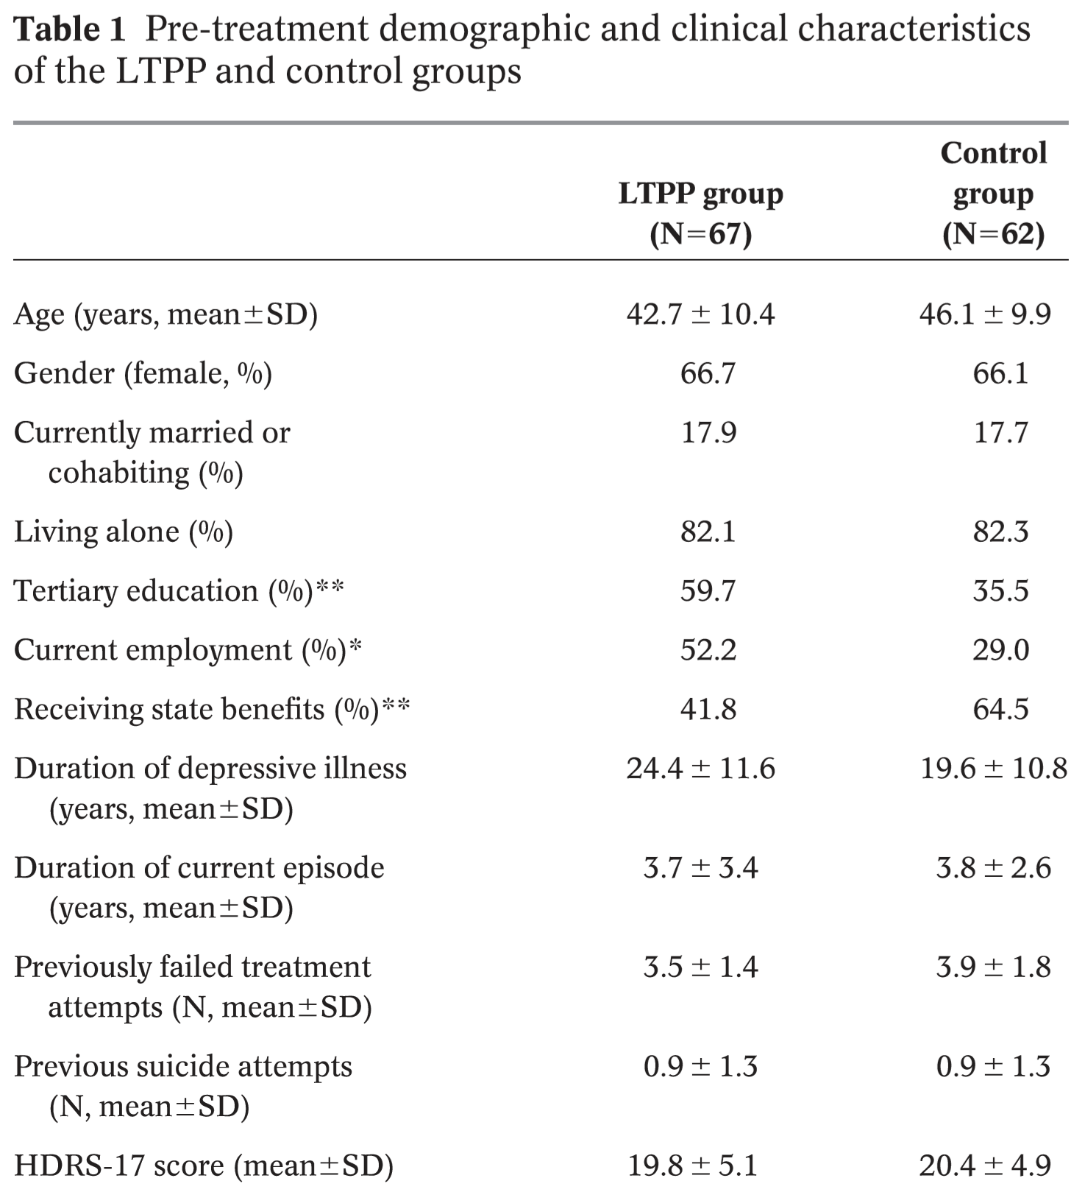
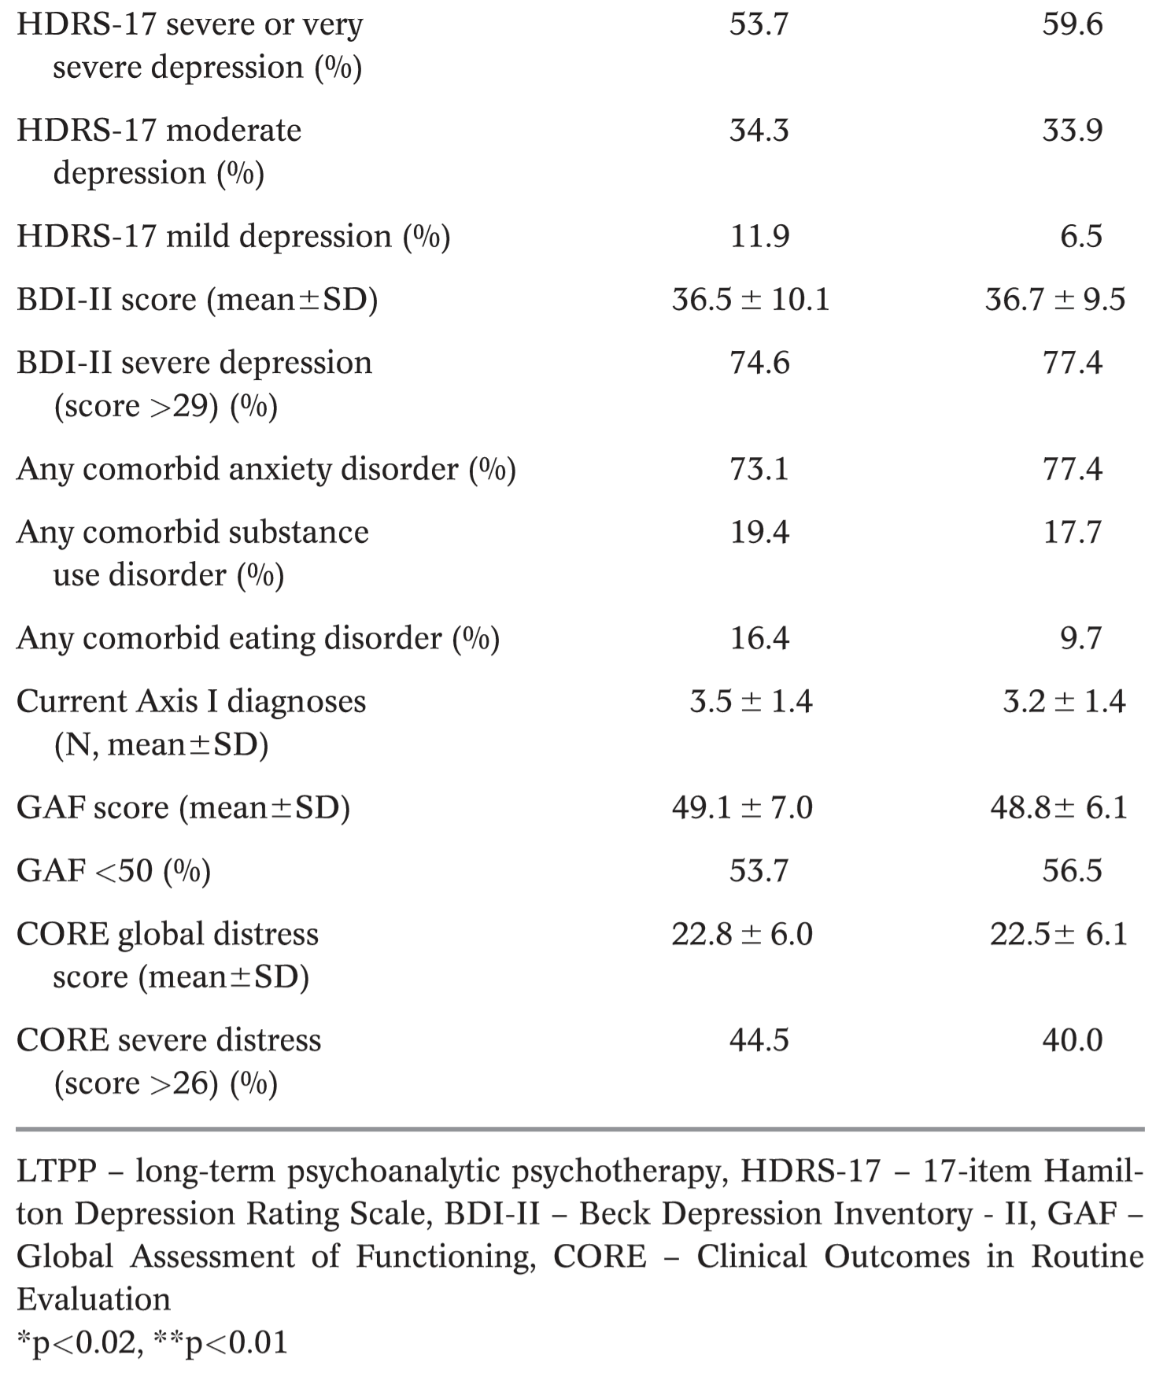
1. Internal validity
Other bias
Baseline imbalance

Slide 32
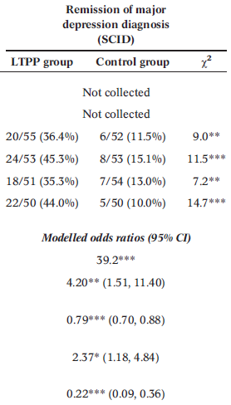
1. Internal validity
Other bias
ITT (Intention-to-Treat analysis)
Adjustments for covariates (only education? why not employment?)
Why not use other methods and perform sensitivity analysis?
LOCF
Worst case scenario
RR = 4.4; 95% CI: 1.7-10.8; NNT = 2.9
Notes:
The ITT is based on modelled OR given covariates. But they are reporting in the text without ITT.

Slide 33
1. Internal validity
Internal validity summary
Risk of Bias (RoB)
Bias domain | Source of bias | Judgment
Selective bias | Random sequence generation | Low
 | Allocation concealment | Unclear
Performance bias | Blinding of participants and personnel | High
Detection bias | Blinding of outcome assessment | Low
Attrition bias | Incomplete outcome data | Low
Reporting bias | Selective reporting | Low
Other bias | Therapist qualiﬁcation/training | Low
 | Treatment ﬁdelity | Low
 | Researcher allegiance | Unclear
 | Baseline imbalance | Low
Higgins JPT, Green S (editors). Cochrane Handbook for Systematic Reviews of Interventions Version 5.1.0 [updated March 2011]. The Cochrane Collaboration, 2011. Available from www.handbook.cochrane.org.

Slide 34
2. External validity
Statistical significance vs Clinical significance
… after 42 months…
Would you like to decrease in average 4.9 points in Hamilton scale? (primary outcome)

Slide 35
2. External validity
Statistical significance vs Clinical significance
… after 42 months…
Would you like to decrease in average 4.9 points in Hamilton scale? (primary outcome)
or… decrease 16.5 points from Beck scale?

Slide 36
2. External validity
Statistical significance vs Clinical significance
… after 42 months…
Would you like to decrease in average 4.9 points in Hamilton scale? (primary outcome)
or… decrease 16.5 points from Beck scale?
or… from a scale to 0 to 100 (GAF scale) would you like to increase 10.9?

Slide 37
2. External validity
Statistical significance vs Clinical significance
… after 42 months…
Would you like to decrease in average 4.9 points in Hamilton scale? (primary outcome)
or… decrease 16.5 points from Beck scale?
or… from a scale to 0 to 100 (GAF scale) would you like to increase 10.9?
WHERE ARE THE MINIMAL IMPORTANT DIFFERENCE (MID or MCID)?

Slide 38
2. External validity
Primary outcome were made for researchers…
… not for clinician nor patients.
complete remission is given by HDRS ≤ 8…
If a clinician tells me that my chances to complete remised after 18 months of treatment increase by 40%, but with a NNT = 34.
Notes:
Maybe partial remission has better outcomes…

Slide 39
2. External validity
Primary outcome were made for researchers…
… not for clinician nor patients.
complete remission is given by HDRS ≤ 8…
If a clinician tells me that my chances to complete remised after 18 months of treatment increase by 40%, but with a NNT = 34.
or… increase by 3.4 to 1, with a NNT = 9.6, at 42 months.
Notes:
Maybe partial remission has better outcomes…

Slide 40
2. External validity
Primary outcome were made for researchers…
… not for clinician nor patients.
complete remission is given by HDRS ≤ 8…
If a clinician tells me that my chances to complete remised after 18 months of treatment increase by 40%, but with a NNT = 34.
or… increase by 3.4 to 1, with a NNT = 9.6, at 42 months.
In general small effect size
Is result relevant?
Notes:
Maybe partial remission has better outcomes…

Slide 41
2. External validity
Best outcome is the remission given depression criteria on SCID
p(remission|experimental) = 0.44; p(remission|control) = 0.10;
RR = 4.4; 95% CI: 1.7-10.8; NNT (1/ARR) = 2.9
Relevant outcomes:
Reduce antipsychotic consumption
Hospitalization
Suicidal attempts/ Deaths
Start working
Outing day
Continue with studies
Start a relationship
Notes:
Absolute Risk Reduction (ARR)

Slide 42
3. Synthesis
Internal validity
External validity
Risk of Bias (RoB)
Bias domain | Source of bias | Judgment
Selective bias | Random sequence generation | Low
 | Allocation concealment | Unclear
Performance bias | Blinding of participants and personnel | High
Detection bias | Blinding of outcome assessment | Low
Attrition bias | Incomplete outcome data | Low
Reporting bias | Selective reporting | High
Other bias | Therapist qualiﬁcation/training | Low
 | Treatment ﬁdelity | Low
 | Researcher allegiance | Unclear
 | Baseline imbalance | High
Patients and participants could be similar
Outcomes not clinically intuitive
No economic cost declared for the 60 session psychanalysis
Only one centre (in London)
Important compare LTPP with other interventions (superiority RCT)
Notes:
Absolute Risk Reduction (ARR)

Slide 43
3. Synthesis
Thanks
Notes:
Absolute Risk Reduction (ARR)

Slide 45
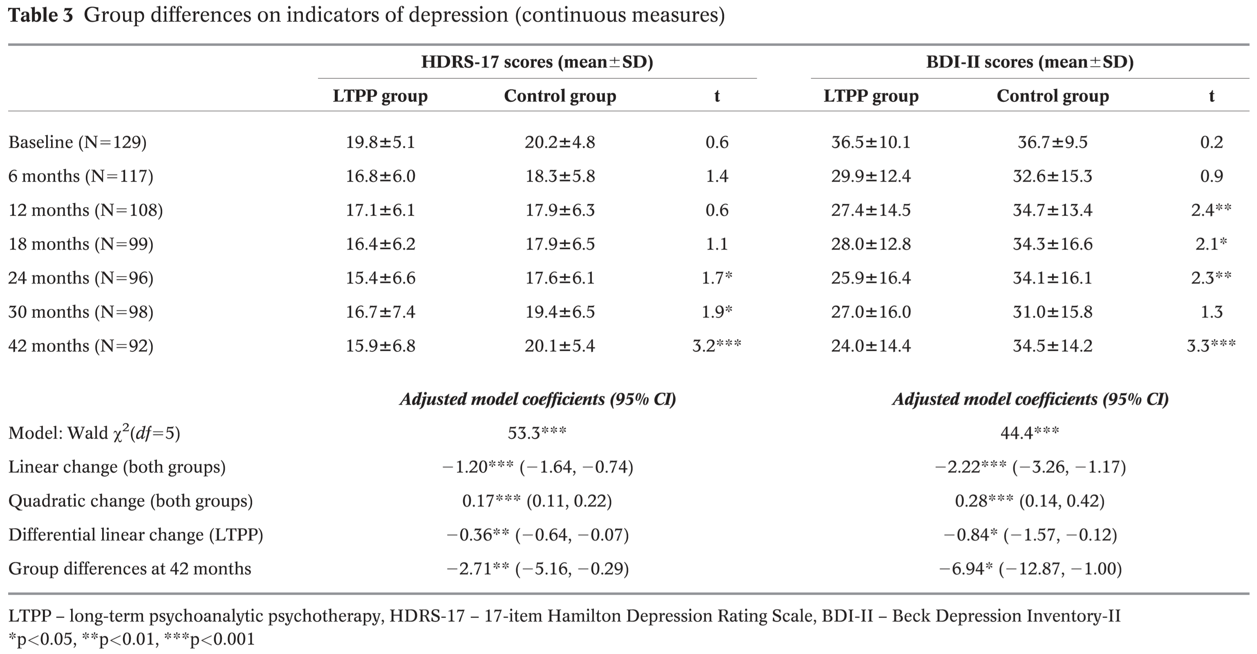

Slide 46
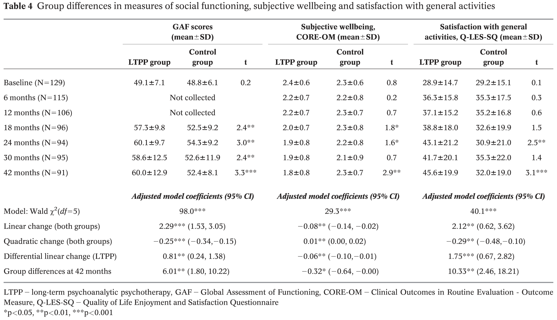

Slide 47
